Slide 1

Stellar Factor
Stargate-inspired Algebra game
Game Developed by:
Kevin Hernandez
Ana Jimenez
Gustavo Pereira
Layla Hoey

Slide 2
Introduction to Stellar Factor
Stellar Factor is a Stargate inspired exploration platformer designed around the Idea of teaching students about factoring.
As the player progresses through the level they will encounter various different math questions scaling in difficulty.
Features 2 Levels
Designed to be a fun, innovative way for students to learn math.

Slide 3
Objectives/Story
In Stellar Factor, you play as a space explorer that has been tasked with exploring the vast extraterrestrial planets.
Along the player will encounter all sorts of different artifacts that need to be collected in order to be able to pass through the stargate.
Each artifact has its own extrinsic math encryption that needs to be solved in order to pick it up.
At the end of each area, the player must face off against a gatekeeper and solve its gate formula. Once answered, the player is able to pass through the stargate.

Slide 4
Models

Slide 5

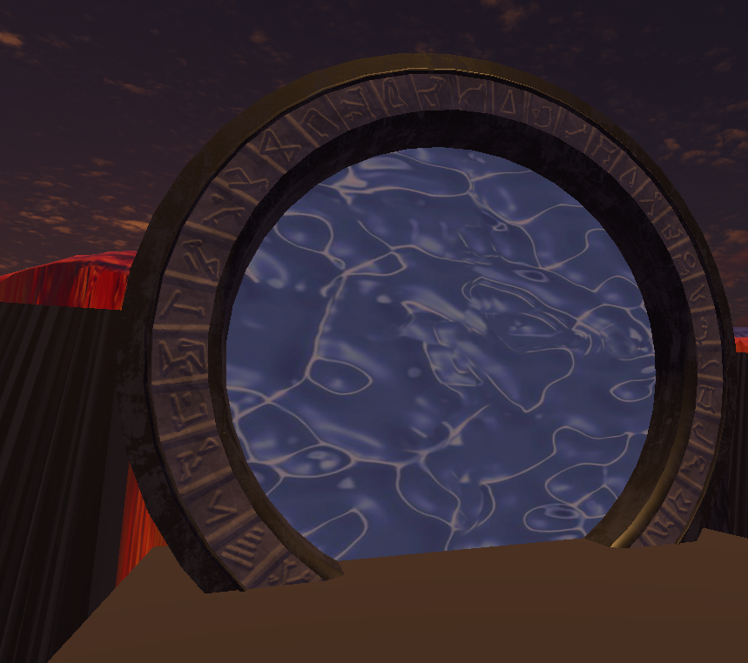
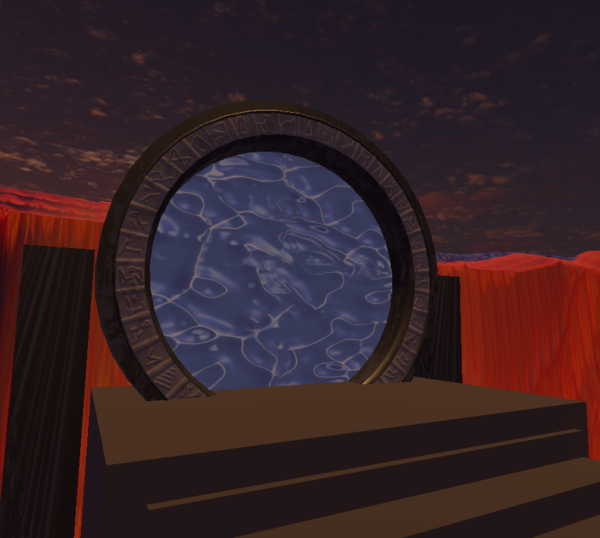
Stargate Model

Slide 6
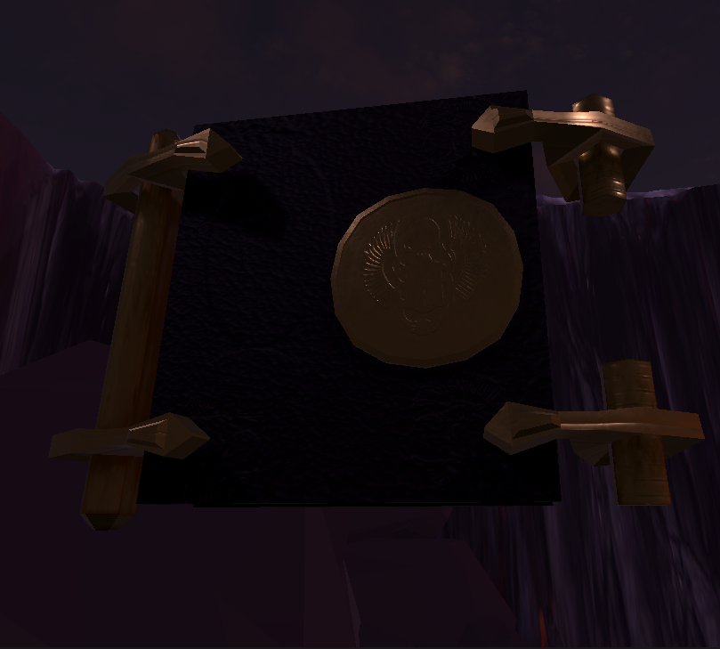
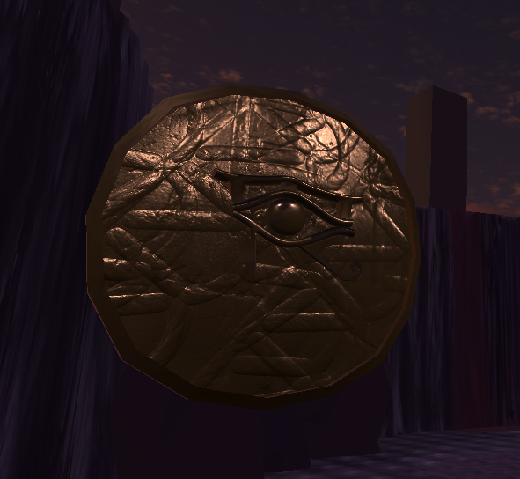
Book of the Dead
Eye of Rah

Slide 7
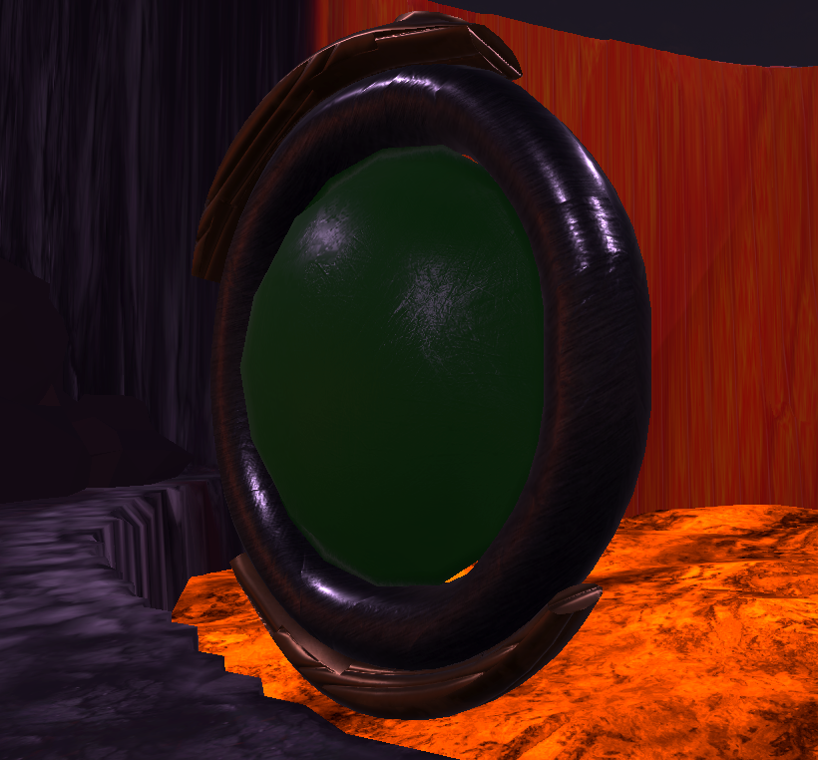
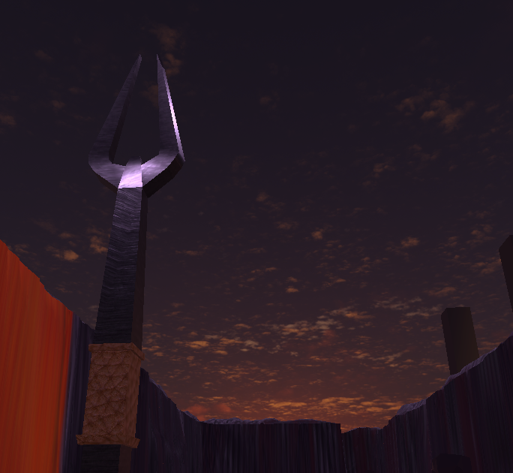
Goa’Uld Ring
Ori Staff

Slide 8
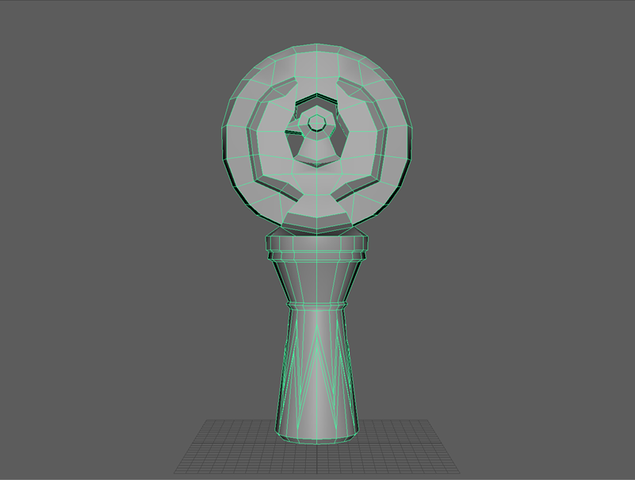
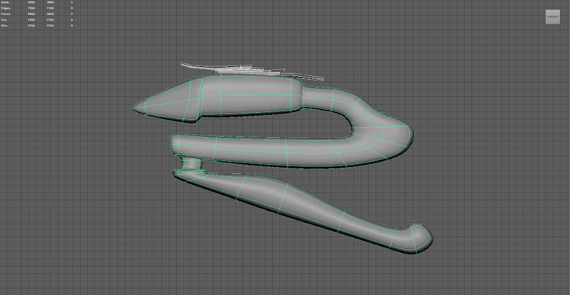
Staff of Ra
Zat’Nik’Tel

Slide 9
Gameplay Demo

Slide 10
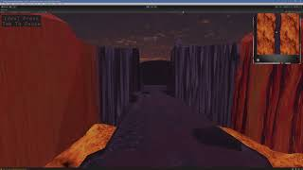

Slide 11
Next Updates (02/13)
Rough draft version of the Level 2 Layout
On-Screen instructions along with directional Indicators showing the player where to go
Incorporate moving lava along the walls of Level 1 along light effects when coming close to an artifact.

Slide 12
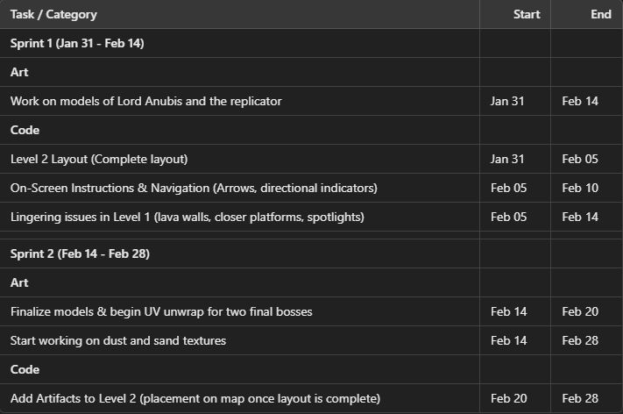
Timeline

Slide 13
Thank You for Listening !
Questions ?

